Slide 1
Statistical Analyses in R
Session 5
Dan Herman
July 17, 2020

Slide 2
July 16 2020 | Session | Instructor
1:00 pm - 1:30 pm | Instructor Introductions, Introduction to technology | Amrom Obstfeld
1:30 pm - 2:15 pm | Introduction to R and RStudio | Joe Rudolf
2:30 pm - 3:15 pm | R basics for Reproducible Reporting | Patrick Mathias
3:30 pm - 5:00 pm | Data Visualization in R | Stephan Kadauke
July 17 2020
1:00 pm - 2:30 pm | Data Transformation | Amrom Obstfeld
2:45 pm - 4:15 pm | Statistical Analysis in R | Dan Herman
4:30 pm - 5:00 pm | Advanced Reporting in R | Patrick Mathias

Slide 3
Goals
Learn how to summarize and assess data
Objectives
Calculate a summary statistic for a variable using `summarize`
Calculate of summary statistic for a variable separately for a group of observations, using `group_by` and `summarize`
Perform a simple test for association

Slide 4
Typical Data Science Pipeline
From R for Data Science (https://r4ds.had.co.nz/introduction.html)
Notes:
In this session we will focus on modeling. But, in the process, we will do a lot more data transformation

Slide 5
Summarize()

Slide 6
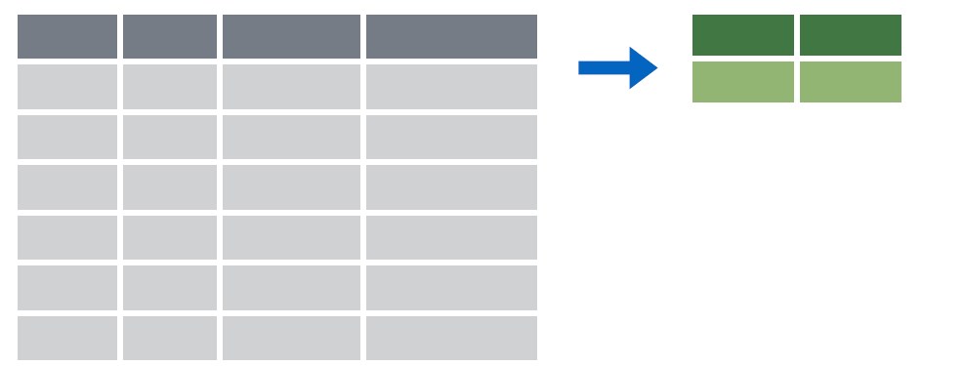

summarize()
Make summaries of your data
Notes:
Apply a function (or functions) to all observations of a variable and return a single value, or summary.

Slide 7
summarize()
Make summaries of your data
covid_testing %>%
summarize(new_variable = calculation)
name for new variable
Value or function

Slide 8
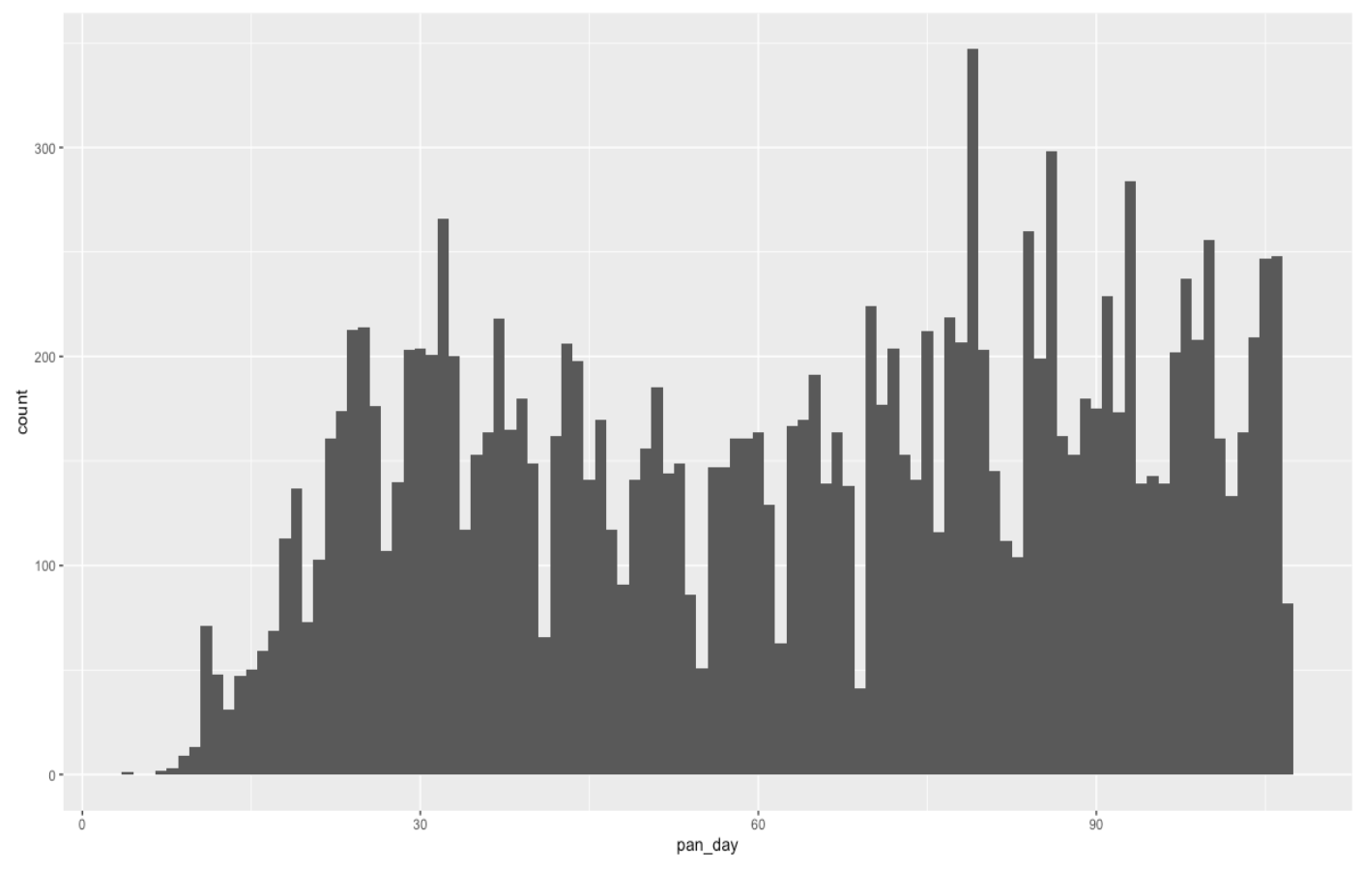
Q: How many tests are ordered per day?

Slide 9
summarize()
function that returns number of observations
Make summaries of your data
covid_testing %>%
select(mrn, pan_day) %>%
head(4) %>%
summarize(order_count = n())
mrn | pan_day
5001412 | 4
5000533 | 7
5009134 | 7
5008518 | 8
order_count
4
Notes:
Note, that to simplify the data frame, we first will select 2 variables and include the first 4 observations.
n() returns the number of observations or rows for a data frame.

Slide 10
summarize()
function that returns number of distinct values
Make summaries of your data
covid_testing %>%
select(mrn, pan_day) %>%
head(4) %>%
summarize(order_count = n(),
day_count = n_distinct(pan_day))
mrn | pan_day
5001412 | 4
5000533 | 7
5009134 | 7
5008518 | 8
order_count
4
day_count
3
Notes:
n_distinct() counts the number of distinct, or unique, observations. So, while there are 4 rows, there are only 3 distinct days

Slide 11

Your Turn 1
- Open “05 – Stats.Rmd”
- Run the setup chunk
- Fill-in gaps to calculate:
a) Mean count of orders per `pan_day`
b) Mean count of orders per clinic
Notes:
*break out*
8 mins

Slide 12
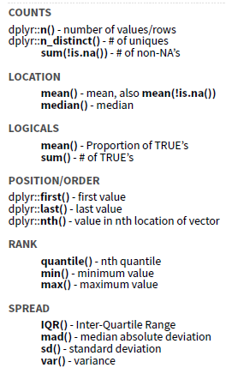
Notes:
There are many different summary functions.

Slide 13
summarize() examples
Last pandemic day (in data)
Median turnaround time
Notes:
n_distinct() counts the number of distinct, or unique, observations. So, while there are 4 rows, there are only 2 distinct patient_id’s.

Slide 14
Your Turn 2
Consider:
How would you calculate the median number of orders per day?
Notes:
The mean was a special case, because it can be calculated using summarize and not explicitly knowing which order is from which patient. But, to calculate the median (find the mid-point of the observations), we need to be able to assess each patient’s observations separately.

Slide 15
group_by()

Slide 16
group_by()
Notes:
Group_by is a challenging function to master, but extremely powerful. It is one of those tools that once you understand how to use, you cannot possibly go back to live without it.
The idea is simple. I have one big data frame and I want to break the observations up into several groups. Then, I’m going to “look at” those groups separately.

Slide 17
group_by()
Grouping observations based on a specific variable’s values
covid_testing %>%
group_by(variable)
name of variable to group by

Slide 18
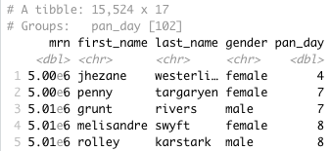
group_by()
Group observations by pan_day
covid_testing %>%
group_by(pan_day)
Notes:
We can see that the resulting object has 15,524 rows that are broken up into 102 groups. Inherently, this means there are 102 distinct `pan_day`’s. Some of these groups will have a single observation. Many of these groups will have more than one observation.

Slide 19
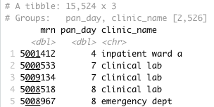
group_by()
Group observations by `pan_day` and `clinic_name`
covid_testing %>%
select(mrn, pan_day, clinic_name) %>%
group_by(pan_day, clinic_name)
Notes:
We can see that the resulting object has 15,524 rows that are broken up into 2,526 groups. Inherently, this means there are 2,526 distinct combinations of `pan_day` and `clinic_name`. Some of these groups will have a single observation. Many of these groups will have more than one observation. Also, not all theoretical combinations of `pan_day` and `clinic_name` exist; only 2,526 such combinations exist.

Slide 20
group_by() %>% summarize()

Slide 21
group_by()
%>%
summarize()
Make summaries of your data by group
Notes:
Just like we can apply summarize() to a full data frame, we can apply summarize() to each group separately.

Slide 22
group_by() %>% summarize()
Make summaries of your data
covid_testing %>%
summarize(order_count = n())
mrn | pan_day
5001412 | 4
5000533 | 7
5009134 | 7
5008518 | 8
order_count
15524
Notes:
Using summarize() without group_by() we can count how many total rows there are.

Slide 23
group_by() %>% summarize()
Make summaries of your data
covid_testing %>%
group_by(pan_day) %>%
summarize(order_count = n())
mrn | pan_day
5001412 | 4
5000533 | 7
5009134 | 7
5008518 | 8
pan_day
4
7
8
9
order_count
1
2
3
9
Notes:
Adding group_by(), we count how many rows there are for each `pan_day`

Slide 24
Your Turn 3
Calculate:
a) The median turnaround time for each day
b) (*Extra*) The median number of orders per day
Notes:
*breakout*
8 mins

Slide 25
group_by() %>% summarize(): Example
Notes:
Number of tests per day. Points for each day. Curve as smoothed point estimate (blue line) and confidence interval (dark gray shading), calculated using local polynomial regression (loess) with default settings.

Slide 26
Stats: Tests for association

Slide 27
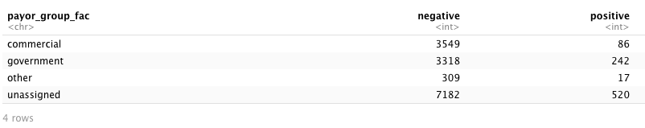
Q: Is there an association between insurance and SARS-CoV-2 RT-PCR positivity?
data %>%
fisher.test(simulate.p.value = T)
Notes:
To ask whether the appears to be a non-random association between whether SARS-CoV-2 RT-PCR tesing result is positive and a patient’s insurance product. We need to create a table organizing our count data and then need to ask how likely is the arrangement of the table counts given that there is no association.

Slide 28
Data wrangling - 1
function that flexibly assigns values
covid_testing_2 <- covid_testing %>%
mutate(payor_group_fac = case_when(
is.na(payor_group) ~ "unassigned",
payor_group %in% c("charity care",
"medical assistance",
"self pay",
"other") ~ "other",
TRUE ~ payor_group)
) %>%
filter(result %in% c("positive", "negative"))

Slide 29
Data wrangling - 2
# Generate counts
tmp_table_tall <- covid_testing_2 %>%
group_by(payor_group_fac, result) %>%
summarize(n = n()) %>%
ungroup()
tmp_table_tall
# Pivot from tall to wide table
tmp_table_wide <- tmp_table_tall %>%
spread(key = "result", value = "n")
tmp_table_wide
Remove groupings
Maps key values to separate columns
Maps key values to separate columns

Slide 30
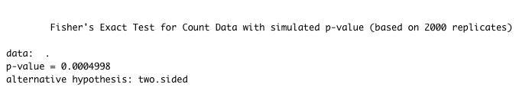
Testing for association
data %>%
fisher.test(simulate.p.value = T)

Slide 31
Your Turn 4
Use fisher.test() to estimate the relative odds of a positive test result for patients with government insurance compared to commercial insurance?
Notes:
*break out*
8 mins

Slide 32
What Else?

Slide 33
Logistic regression
tmp_fit <- glm(result_fac ~ payor_group_fac + age, # model formula
data = tmp, # dataset
family = "binomial") # type of model
summary(tmp_fit)

Slide 34
Goals
Learn how to summarize and assess data
Objectives
Calculate a summary statistic for a variable using `summarize`
Calculate of summary statistic for a variable separately for a group of observations, using `group_by` and `summarize`
Perform a simple test for association

